Slide 1

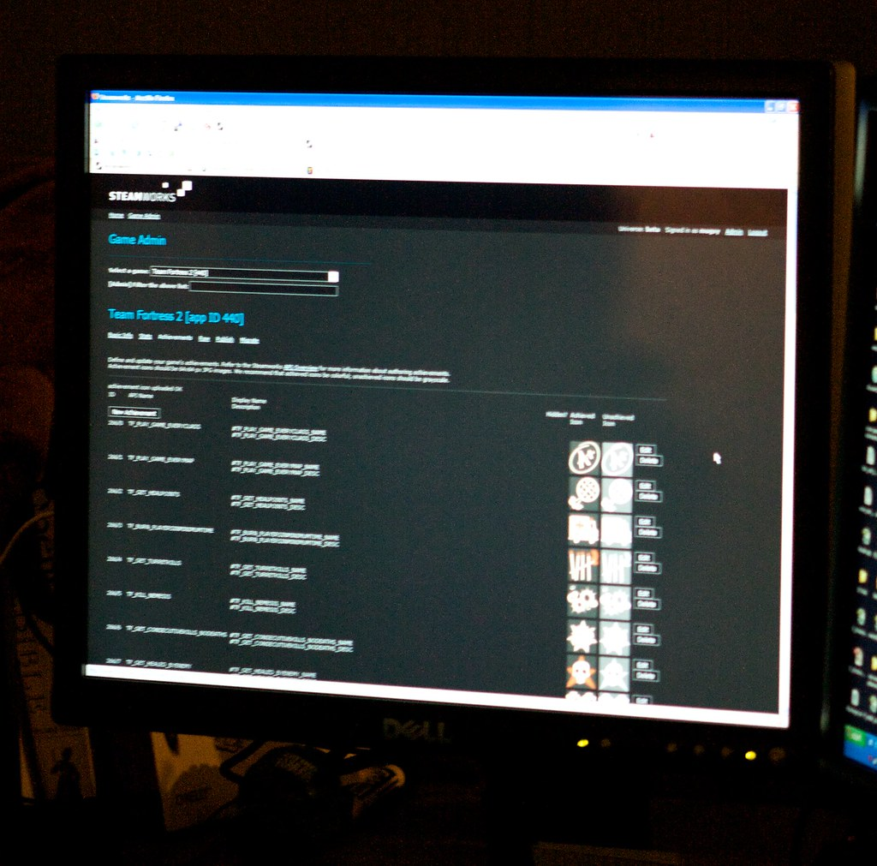

High Level Architecture Diagram
User interaction
Language: HTML, CSS, JavaScript
Application logics
Language: Java, JavaScript
Users
Enter the blog
Request
Display the blog
Response
Frontend
Backend
Web Application Architecture

